Slide 1


SMART INDIA HACKATHON 2024
Problem Statement ID- 1582
Problem Statement Title- System to check the healthiness of earthing system and alert staff in case of any malfunction.
Theme- Miscellaneous
PS Category- Hardware
Team ID-
Team Name – FLUX
my

Slide 2
IDEA /APPROACH DETAILS
FLUX
INNOVATION
SOLUTION
We have designed a device to check and maintain healthiness of earthing system.
The device has following functions:
Fault Prediction Model
Compact Device
Cost-effective
Real time Access
Centralized platform
User-friendly software
Our earthing health monitoring solution designs a device and a software which provides comprehensive oversight through three key functionalities:
1)Real-time Earthing Voltage Monitoring: Continuously measures voltage levels to ensure optimal earthing performance.
2)Earth Leakage Current Tracking: Detects and monitors abnormal leakage currents to identify potential hazards.
3) Fault Prediction: Utilizes advanced algorithms to anticipate potential earthing failures, enabling proactive maintenance.

Slide 3
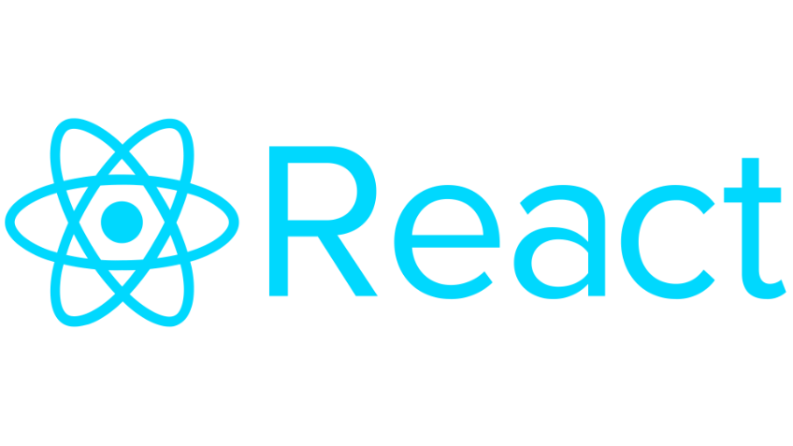

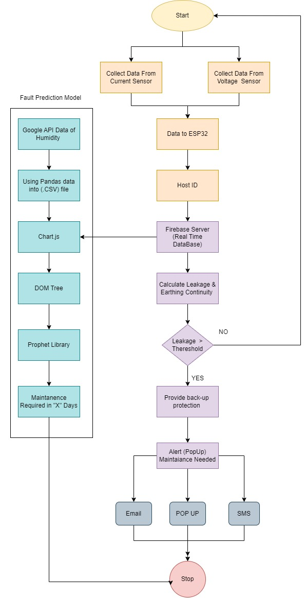











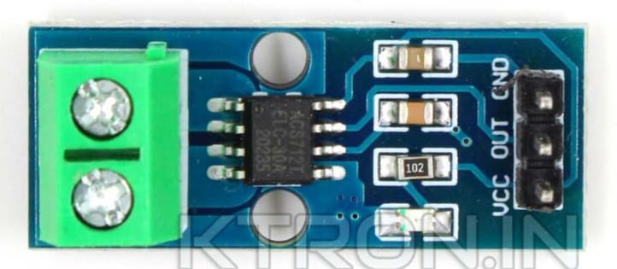
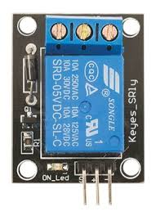
TECHNICAL APPROACH
FLUX
TECHNOLOGY STACK:
METHODOLGY/FLOWCHART
HARDWARE COMPONENTS:
ESP32 or ESP8266
ACS712 (current sensor)
ZMPT101B (voltage sensor)
SRD-5VDC-SL-C (Relay)

Slide 4
FEASIBILITY AND VIABILITY
FLUX
FEASIBILTY
STRATEGIES TO OVERCOME THE CHALLENGES
User-friendly Interface
Real-time access
Centralized Platform
Cost-effective
Use more robust and accurate sensors with built-in filtering and compensation.
Implement redundancy and fail-safe mechanisms to ensure continuous monitoring.
Develop advanced algorithms to predict faults with higher accuracy and fewer false alarms.
Provide a scalable architecture that can be easily deployed and managed across multiple sites.
Incorporate self-diagnostic features and remote maintenance capabilities to reduce overhead.
POTENTIAL CHALLENGES AND RISKS
Potential for False Alarms
Lack of Robustness
Inaccurate measurements from faulty sensors
Scalability Issues
Maintenance Overhead

Slide 5
IMPACT AND BENEFITS
FLUX
POTENTIAL IMPACT AND BENEFITS ON TARGET AUDIENCE:
Reduced risk of electrical accidents: By detecting and alerting to potential hazards like earth leakage currents, the system helps prevent accidents and injuries
Reduced Power Outages: Improved earthing performance led to a substantial reduction in power surges and voltage fluctuations, minimizing equipment damage and downtime.
Minimized equipment replacement: Early detection of faults can prevent catastrophic failures that may damage valuable equipment and require costly equipment replacements.
Cost Savings: By preventing equipment failures and reducing downtime, the facility realized significant cost savings.
Compliance with Regulations: The system ensured compliance with industry standards and regulations related to earthing systems.

Slide 6
RESEARCH AND REFERENCES
FLUX
Details / Links of the reference and research work

